Slide 1

Data Regulation Session 1: General introduction
Me Adrien Basdevant, October, 4th, 2021

Slide 2
« Creating here the law of tomorrow»
Strategic Thinking
Litigation
Agreement Negotiations
Training
Cutting-edge issues: AI, blockchain, encryption, platforms regulation, software, media, telecom, digital rights
Law
Policy
Tech
Me Adrien Basdevant, 19 juin 2020

Slide 3
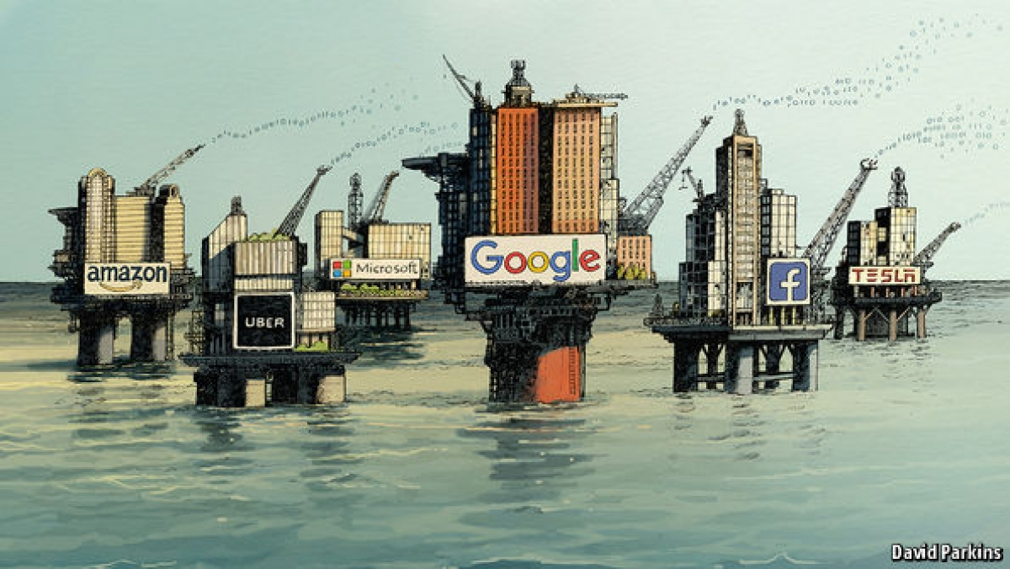
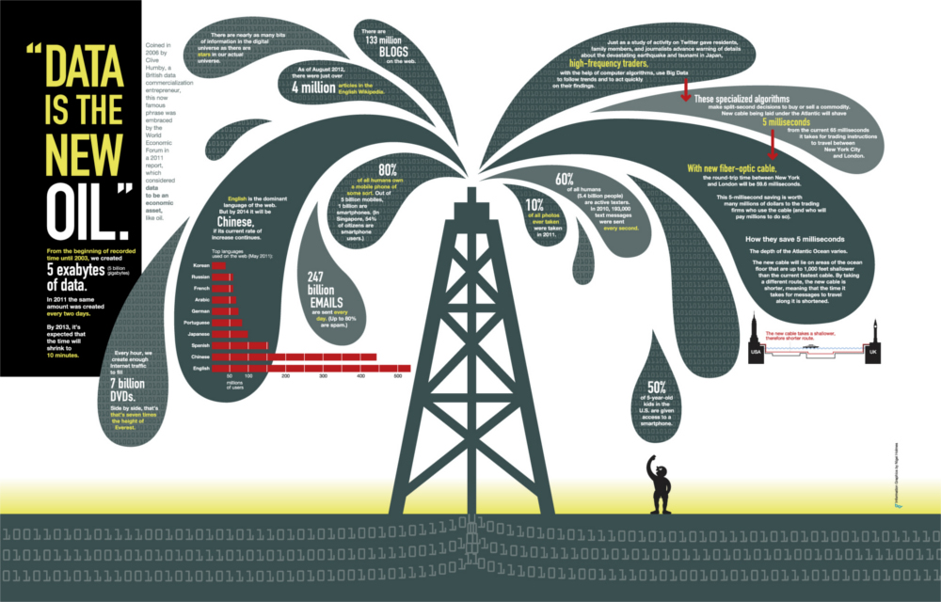

« Data is the new oil »
Notes:
As often, we will start ou presentation recalling that « Data is the new oil »

Slide 4
Data is NOT the new oil
Notes:
But, I won’t.
Sorry : Data is not the new oil.
So what are we doing here? I ask myself the same question.
But more seriously, data is not the new oil because :
Oil is a limited ressource
Oil is rivalrous
Oil is fungible (you can change one baril for another)
However, data is not a limited resource, non-rivalrous and non-fungible. It could be mutually
beneficial.
This is what we are going to talk about today: how can we share data and its value

Slide 5
What is « data »?
Personal Data
Anonymized Data
= zero risk of re-identification
3 critera (G29 Opinion) :
Singling out
Inference
Correlation
Sensitive Data
Location
Data
Pseudonymized
Data
…
What about Non-Personal Data ?
Notes:
But first what is data, I mean in a legal sense?
Personal data = any information relating to an identified or identifiable natural person
Anonymisation results from processing personal data in order to irreversibly prevent identification
Case studies and research publications have shown how difficult it is to create a truly anonymous dataset
The opinion elaborates on the robustness of each technique based on three criteria: (i) is it still possible to single out an individual, (ii) is it still possible to link records relating to an individual, and (iii) can information be inferred concerning an individual?
The main anonymisation techniques, namely randomization and generalization often lead to pseudonymous data not anonymized data

Slide 6
Data Regulation
Breaking news : Not all data… are personal
Lawyers hang on to what they know, but most of the data is not necessarily linked to an individual.
E.g.: temperature variation, speed of a machine, technical information collected by an IoT sensor...
Tomorrow, there will be a full-fledged data law
This regime will regulate the use of personal, non-personal and hybrid data.
Notes:
1978 : LIL 40 years ago
Comparaison with open source

Slide 7
A European strategy for data (1/3)
Published on February 19th 2020 by the European Commission
Based on several observations:
Data is an essential tool for the governance of our societies
The majority of the data is held by a small number of actors
Distinction between personal data and industrial data
Existing European data legislations that however are not harmonized
Notes:
We lost B2C
We will not B2B
(e.g. digital twin)

Slide 8
A European strategy for data (2/3)
Proposing several tracks:
Central issue of encouraging data sharing and the equitable sharing of its value
Data availability on 4 scenarios :
G2B = sharing of data from the public to the private sector
B2B = sharing of data between private entities
B2G = sharing of data from business to the public sector
G2G = sharing of data between public entities
Notes:
Use of public sector information by business (government-to-business – G2B – data sharing).
Sharing and use of privately-held data by other companies (business-to-business – B2B – data-sharing
Use of privately-held data by government authorities (business-to-government – B2G – data sharing
Sharing of data between public authorities

Slide 9
A European strategy for data (3/3)
Next steps:
Detail action plans for the 9 common data spaces of strategic sectors and areas of public interest (industry, green pact, mobility, health, energy, agriculture, public administration, skills and finally a common financial data space) = in 2020
Adopt an implementing act on high-value datasets to deploy standard APIs that will make more high-quality public sector data available = early 2021
Propose a European Data Act = 2021 (NB: this scheduled calendar was B.C.)

Slide 10
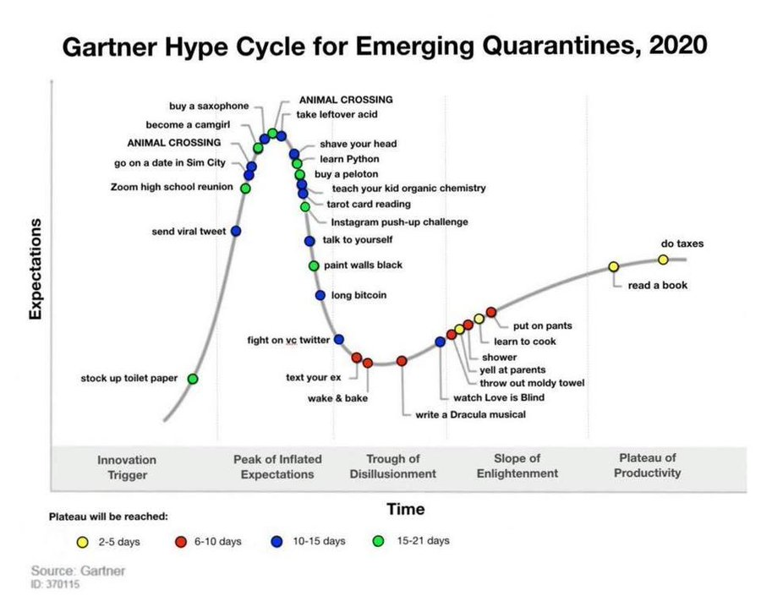

Slide 11
Data « ownership »
There is no right of ownership (usus, abusus, fructus) of the data.
Parallel with intellectual property (IP) rights
Reconciliation with confidentiality & trade secrets
Notes:
Très bon rapport du MIT « Promise, reality, and a future of data sharing” du mois dernier
Concret use case : imagine your provide the IoT, and provide the analytics (AI), etc. who owns what

Slide 12
The reason for Security-Preserving ML
In order to convince users/partners to hand over personal data way more efficiently:
How can we enable ML on (sensitive) data while providing strong privacy guarantees?
How to make data sharing among parties/competitors possible ?
→ SPML allows data to be shared in a way that preserves users’ privacy and data utility
Notes:
Data owner protection (privacy preservation)
Differential Privacy
Federated Learning
Model owner protection (secure computation)
Homomorphic Encryption
Secure Multi-Party Computation
An algorithm is said “differentially private” if an observer examining the output is not able to determine whether a specific individual’s information was used in the computation
Federated learning : Machine Learning on distributed data sets
Fully homomorphic encryption enables the computation on encrypted data, with operations, such as addition and multiplication, that can be used as the basis for more complex arbitrary functions. Because of the high cost associated with frequently bootstrapping the ciphertext (refreshing the ciphertext because of the accumulated noise).
When a model has multiple owners, multi-party computation allows for individuals to share control of a model without seeing its contents such that no sole owner can use or train it
Multi-party computation (MPC) is a technique, where computations are performed on the secret inputs from various parties. The parties gain no additional information about each other’s inputs, except from what can be learned from the output

Slide 13
New Legal Challenges
Pollution (negative externalities)
Competition
Interoperability, quality
Portability
Imbalances in market power
Value Sharing (re: property, revenue sharing, etc.)
Cybersecurity
Notes:
The European data space will give businesses in the EU the possibility to build on the scale of the Single market. Common European rules and efficient enforcement mechanisms should ensure that: - data can flow within the EU and across sectors; - European rules and values, in particular personal data protection, consumer protection legislation and competition law, are fully respected; - the rules for access to and use of data are fair, practical and clear, and there are clear and trustworthy data governance mechanisms in place;there is an open, but assertive approach to international data flows, based on European values.

Slide 14
GDPR, new buzzword?
Cloud, AI, Big Data, Blockchain… now GDPR?
Fines up to 4% of the company’s global turnover, frightening but the real issue is TRUST
How can we make data governance a competitive asset?
Put differently, how do I establish a GDPR culture within my organization?
… and make my entire organisation responsbible for maintaining compliance over the long term?

Slide 15
GDPR, new buzzword?
Data Protection Regulation follows 2 goals
Free flow of information
Protection of civil liberties and fundamental rights
Technology neutral
Applies fully to the use of personal data in AI

Slide 16
A few misconceptions
‘’My organization is not located within the EU’’
‘’I own the data that I use’’
‘’This data does not contain any first or last names’’
‘’This data is handled by one of my contractors’’
‘’I have already filed declarations to the Data Protection Authority’’
I should not be concerned by these issues since:

Slide 17
Quick timeline of the applicable legislation
1976: Sweden, Germany
1978: French loi informatique et libertés
1995: EU Directive
2012: Proposal for GDPR
2016: Adopted version of the GDPR
May 25th, 2018: effective application of the GDPR
And tomorrow, opinions from:
Data protection authorities
The European Data Protection Board
National and CJEU case-law

Slide 18
Key concepts
What?
Personal data vs anonymized data
Lawful basis for processing (consent, performance of contract, legal obligations, etc…)
NB: specific legal grounds for sensitive data!
Who?
Data controller
Data processor
Data subject

Slide 19
Key concepts
Lawful, fair and transparent process personal data shall be collected for specified, explicit and legitimate purposes
It shall not subsequently be further processed in a manner which would be incompatible with those primary purposes
Data must be accurate and, where necessary, kept up to date
Promote a limited and proportionate conservation period
Data minimisation (i.e. limited to what is necessary in relation to the purposes for which they are processed)
Ensure that only authorised personnel have access to it

Slide 20
Data subjects’ rights
Right to be informed
Information should be transparent
Information given to the data subject
Efficient and succinct
Easily accessible
Right to access: know if personal data is being processed and in this case access the data
Right to object (e.g.Direct marketing)
Right to rectify inacurate data
Right to restrict processing

Slide 21
Data subjects’ rights
Right to be forgotten (erasure/ dereferencing)
Regarding information no longer relevant
Eg: Google Spain case (only applies within the EU)
Right to data portability
Child consent
Has to be given by a parent if the child is under 16 years old
Rights related to automated decision making and profiling
Right not to be subject to a decision based solely on automated processing
Right to understand the underlying algorithmic reasoning

Slide 22
Major changes in the GDPR
A regulation harmonizing EU rules
A broader territorial scope
The ‘’accountability’’: upstream corporate accountability
New definitions: profiling, personal health data...
Joint responsibility for data controllers and data processors
Level of sanctions: up to 4% of global turnover or 20 million €

Slide 23
How to get ready?
Appoint a Data protection Officer
Map your data
Perform an audit
Establish a record of processing activities
Hold internal documentation
If necessary carry out a Data Protection Impact Assessment
Review contractual clauses (employees, contractors)

Slide 24
How to get ready?
Know how to respond to data leaks
Manage data subjects’ requests
Follow a retention and archiving policy
Comply with codes of conduct / certifications
Educate and train your organization

Slide 25
Data controllers’ obligations
Provide comprehensive Privacy Notices
International transfers if adequate level of protection
Establish Privacy by design and by default
Notify any data breaches

Slide 26
Follow European guidelines and opinions
Guidelines 05/2020 on Consent (WP259)
Guidelines 04/2020 on the use of location data and contact tracing tools in the context of the Covid 19 outbreak
Guidelines 1/2020 on processing personnal data in the context of connected vehicles
Guidelines 3/2019 on processing of personal data through video devices
Guidelines on Personal data breach notification (WP250)
Guidelines on Automated individual decision-making and Profiling (WP251)
Guidelines on Transparency (WP260)

Slide 27
GDPR is an opportunity
Data minimization
Profiling / Scoring ( coach, talent)
Free comment Sections
Build confidence
A competitive advantage
Watch out how you communicate
Ethics by design
Lead by example

Slide 28

Tension between AI & GDPR
Data minimisation and accuracy
Large data and complex sets required to train, test and deploy AI systems
Purpose limitation
Unforseen purposes beyond original scope
Transparency
Black Box
Retention limitation
Needs to retain data for AI training, deployment, oversight
Individual rights
Cannot always facilitate access, correction or explanation of the logic involved

Slide 29
Adrien Basdevant ab@basdevant.tech 2 rue des Haudriettes, 75003 Paris www.basdevant.tech www.coupdata.fr

